Slide 1
Results Antonym generation

Slide 2
Generate Antonyms from scratch
Approach:
User selects a category (e.g. Countries)
Search Wikipedia for entries out of the category (e.g. germany)
Retrieve Wikipedia article from entry
Look up antonyms for each word used in the article
Add word- antonym pair to set of pairs
Select Top n (e.g. 300) pairs with “Orthogonality maximization” (from POLAR)
Transfer model into Polar space (from POLAR)

Slide 3
Example Countries
Used Wikipedia pages of Countries with biggest GDP (e.g. USA, China, Japan, Germany…)
Generated Antonym pairs: 1677 (adding more countries didn’t increase this Number too much)
Applied Polar with 300 Dimensions
First observation: Most generated antonyms are very general and non-expressive for the category, e.g.
('known', 'unknown'), ('equal', 'differ'), ('central', 'peripheral'), ('north', 'south'), ('federal', 'unitary'), ('major', 'minor'), ('square', 'round'), ('straight', 'crooked'), ('most', 'fewest'), ('most', 'least'), ('uppercase', 'lowercase'), ('new', 'old'), ('new', 'worn'), ('least', 'most’) ('notice', 'ignore'), ('marked', 'unmarked'), ('worsen', 'better'), ('refuse', 'accept'), ('export', 'import')
However, some interesting ones:
('urban', 'rural'), ('military', 'civilian'), ('nuclear', 'conventional'), ('nuclear', 'conventional'), ('civil', 'uncivil'), ('war', 'peace'),

Slide 4
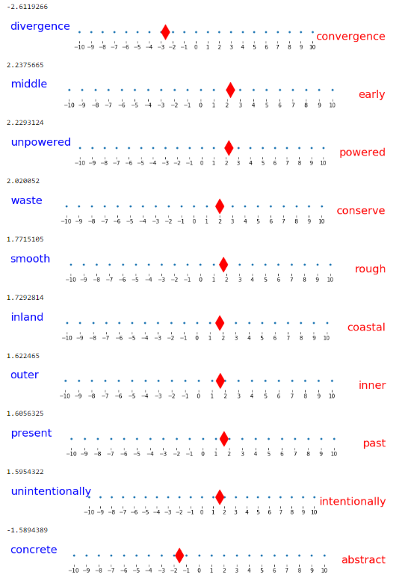
USA

Slide 5
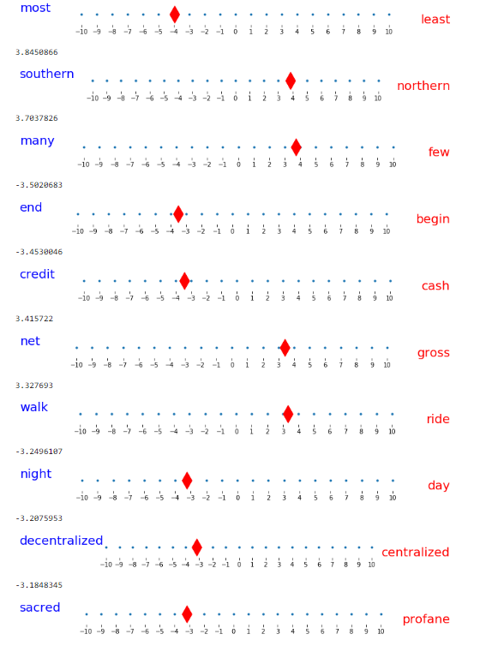
China

Slide 6
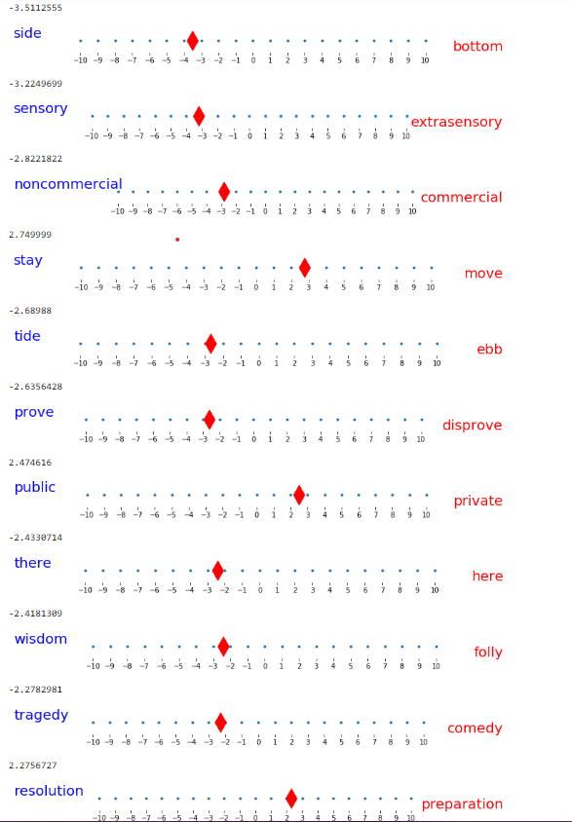
Can you guess? Probably not

Slide 7
Same for music genres
('popular', 'unpopular'), ('like', 'dislike'), ('like', 'unlike'), ('traditional', 'nontraditional'), ('equal', 'differ'), ('most', 'fewest'), ('most', 'least'), ('on', 'off’), ('western', 'eastern'), ('many', 'few'), ('deviate', 'conform'), ('take', 'give'), ('accept', 'refuse'), ('necessitate', 'obviate'), ('consume', 'abstain'), ('claim', 'disclaim’), ('sound', 'silence'), ('have', 'lack'), ('new', 'old'), ('new', 'worn'), ('adopted', 'native'), ('record', 'erase'), ('studio', 'location'), ('particular', 'general'), ('specific', 'general’), ('specific', 'nonspecific'), ('used', 'misused'), ('general', 'particular'), ('general', 'specific'), ('general', 'local'), ('more', 'less'), ('more', 'fewer'), ('familiar', 'unfamiliar'), ('familiar', 'strange’), ('win', 'lose'), ('gain', 'reduce'), ('popularity', 'unpopularity'), ('powerful', 'powerless'), ('appearance', 'disappearance'), ('late', 'early'), ('begin', 'end'), ('start', 'stop'), ('cover', 'uncover’)

